Slide 1
Robot Mobility
OU Robotics Club
September 25, 2014

Slide 2
Tonight’s Goals
Learn about different types of drive systems
Learn about motor control with PWM and H-bridges
Implement automated control of a 2-wheeled robot
Implement control of a 2-wheeled robot over serial

Slide 3
Drive Systems

Slide 4
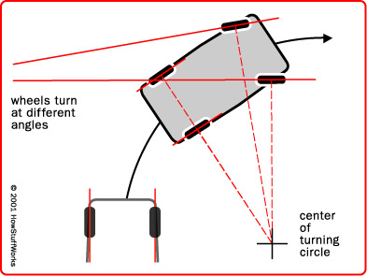
Drive Systems: Car Steering
Image credit: HowStufWorks.com

Slide 5
Car Steering Pros and Cons
Pros:
Only needs one motor
Good at going straight
Cons:
Bad at turning
Mechanically complicated

Slide 6
Today’s Word of the Day:
Holonomic

Slide 7
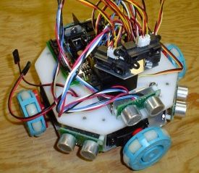
Drive Systems: Omniwheels
Image credit: SocietyOfRobots.com

Slide 8
Omni-wheel Pros and Cons
Pros:
Can translate in any direction without turning
Can turn without translating
Cons:
Takes at least 3 motors
Control slightly complicated
Performs poorly on uneven surfaces

Slide 9
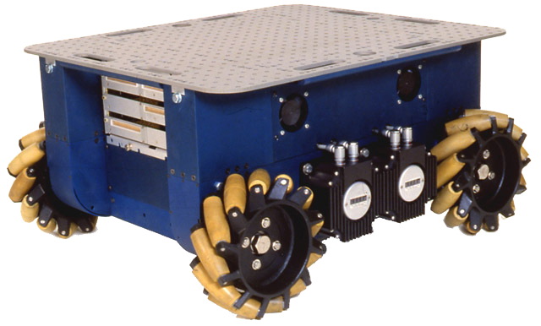
Drive Systems: Mecanum Wheels
Image credit: Wikipedia

Slide 10
Mecanum Wheels Pros and Cons
Pros:
Can translate in any direction without turning
Can turn without translating
Cons:
Takes at least 4 motors
Control quite complicated
Performs poorly on uneven surfaces (but better than omni-wheels)

Slide 11
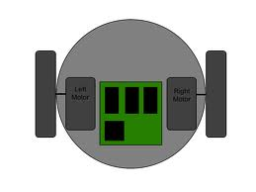
Drive Systems: 2-Wheel Differential
Image credit: Robotix.in

Slide 12
2-Wheel Differential Pros and Cons
Pros:
Can execute zero-point turn
Control is very simple
Mechanically very simple
Cons:

Slide 13
Motor Speed Control

Slide 14
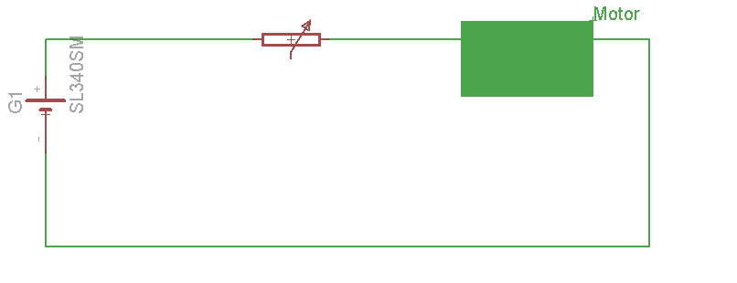
A basic approach
What’s wrong with this?

Slide 15
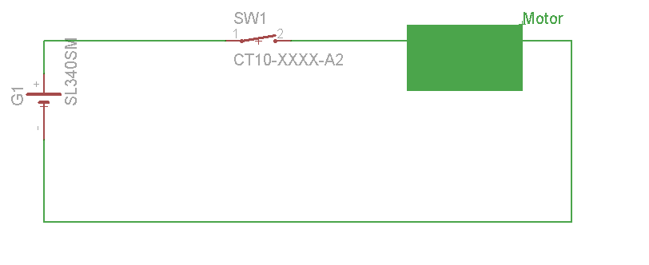
A better approach

Slide 16
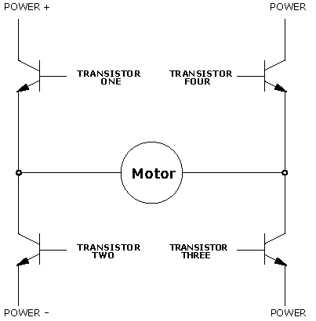
A great approach
Image Credit: clear.rice.edu

Slide 17
A great approach
Image Credit: clear.rice.edu

Slide 18
A great approach
Image Credit: clear.rice.edu

Slide 19
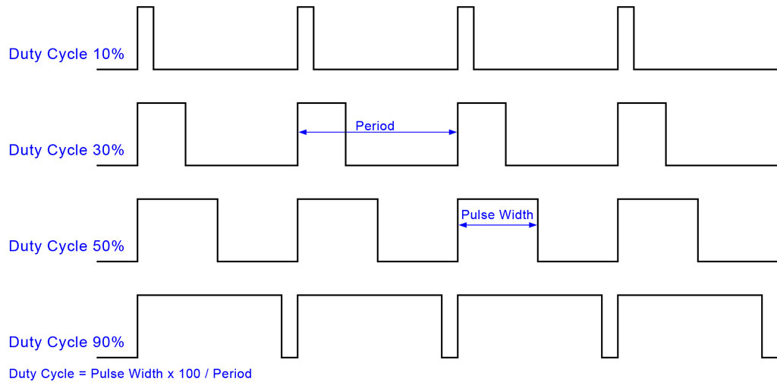
PWM: Pulse Width Modulation
Image credit: protostack.com

Slide 20
Making Today’s Robot

Slide 21
Wiring the H-Bridge
Image credit: Pololu.com, then modified

Slide 22
The Code
Get the setupMotors and setMotors functions from http://pastebin.com/NE3P9NGV and include those methods in your file.
Write your own “setup” and “loop” functions
Be sure to call the setupMotors() function once during the setup function. Call setMotors(leftSpeed, rightSpeed) as often as you like.

Slide 23
The Task
Program the robot to drive in a pattern (e.g. a square) by issuing movement and delay commands

Slide 24
My solution
void setup(){
setupMotors();
}
void loop(){
setMotors(255,255);
delay(2000);//times may vary
setMotors(255,-255);
delay(1500);//times may vary
}

Slide 25
The Challenge
Program the robot to take serial data so that you can remote control it with the keyboard.
Include Forward, backward, left, right, speed up, and slow down.
void setup(){
setupMotors();
Serial.begin(9600);
}
void loop(){
while(!Serial.available());
char c = Serial.read();
switch(c){
//handle the characters
}
}

Slide 26
My solution
See my solution at http://pastebin.com/ZTkRPTDu

